Slide 1


MSBI.DEV
Course
S18E12
March 31, 2018

Slide 2
IN PREVIOUS PART: S18E11
Using Tools to Analyze Query Performance
Implementing Indexes and Statistics
Temp table and table variable

Slide 3
S18E12 AGENDA
BI. Business Intelligence
Designing and Implementing a Data Warehouse
Introducing Star and Snowflake Schemas
Designing Dimensions
Designing Fact Tables

Slide 4
S18E12 Business Intelligence
Business Intelligence
BI

Slide 5

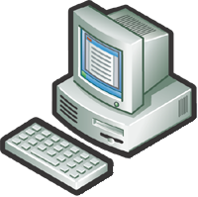





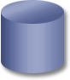
Why BI? Business Intelligence. The Five Questions
What happened?
What is happening?
Why did it happen?
What will happen?
What do I want to happen?
Past
Present
Future
Data
ERP
CRM
SCM
3Pty
Black books

Slide 6
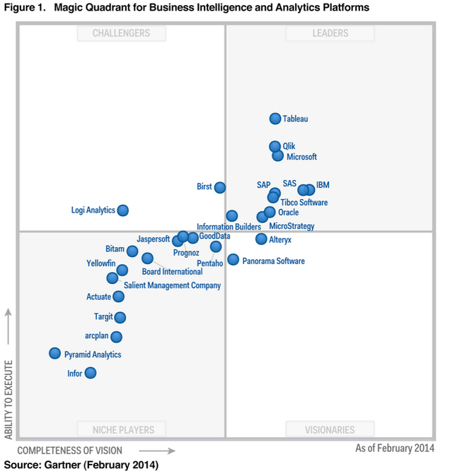
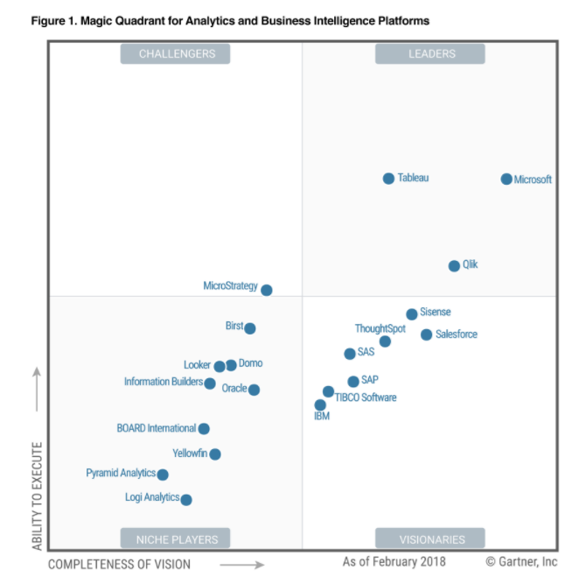
Business Intelligence.

Slide 7
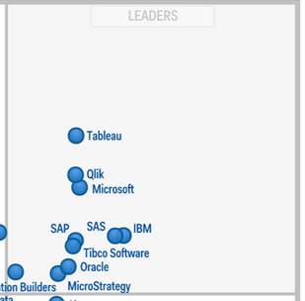
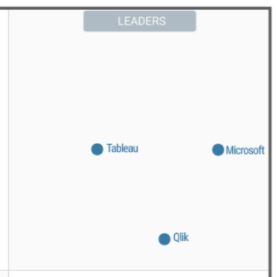
Business Intelligence.

Slide 8
MS BI Architecture

Slide 9
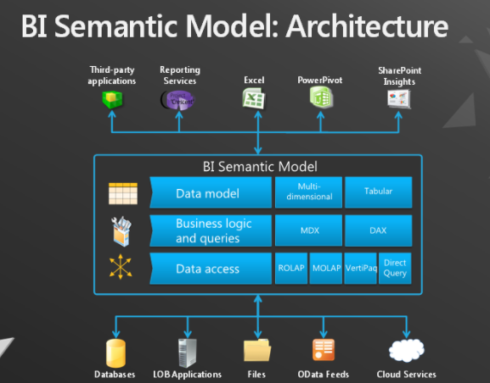
MS BI Architecture

Slide 10
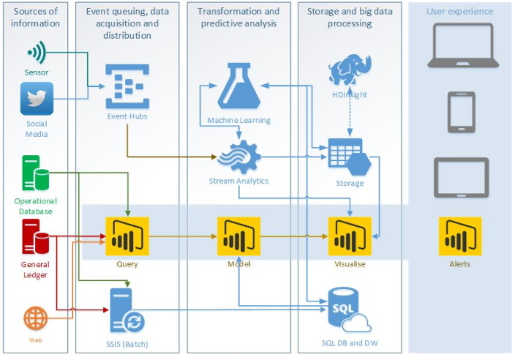
MS BI Architecture

Slide 11
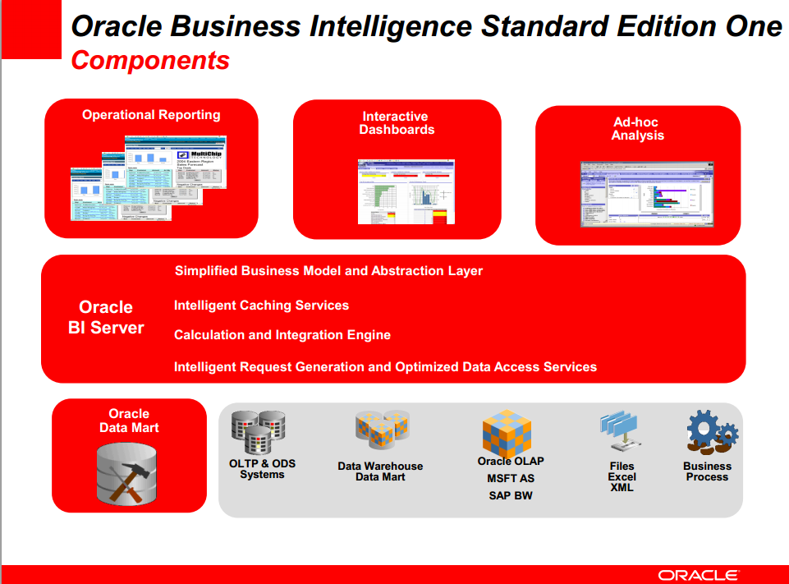
Oracle BI Architecture

Slide 12
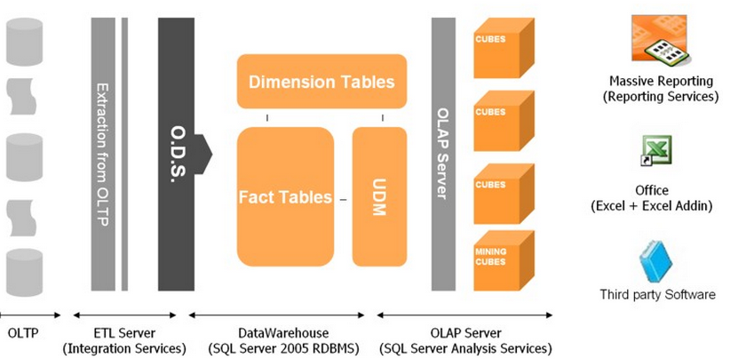
Common BI solution architecture

Slide 13
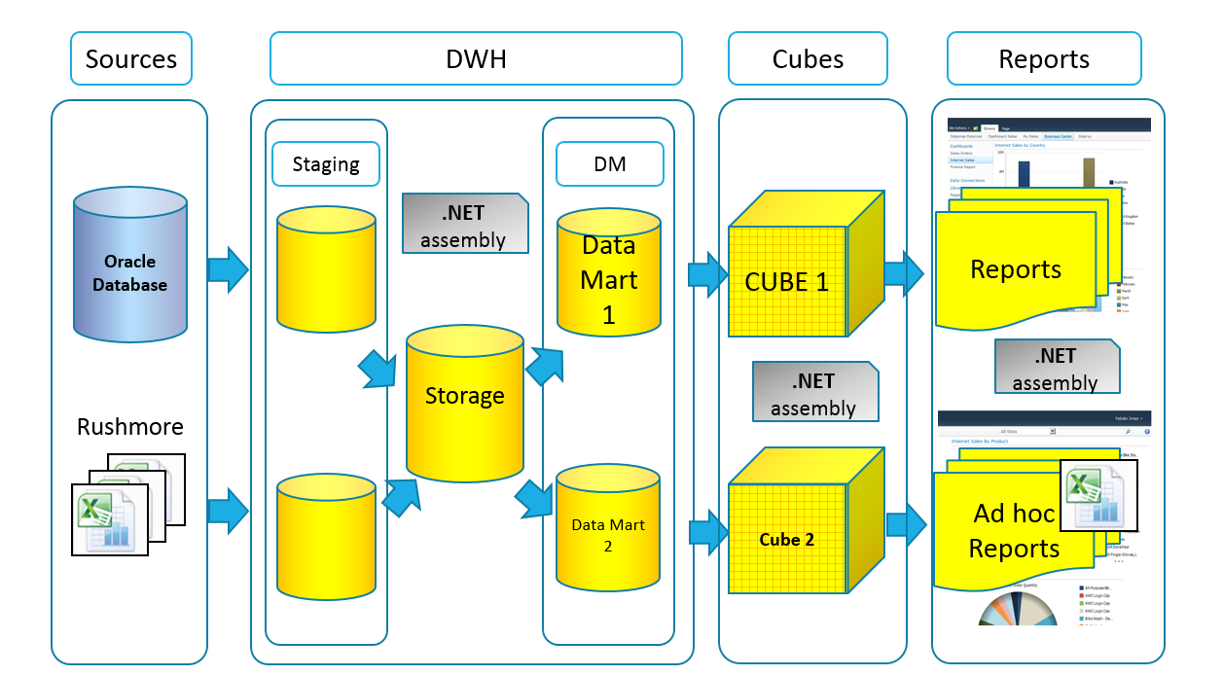
Common BI solution architecture

Slide 14
Data Warehouse Logical Design
Designing and Implementing a Data Warehouse

Slide 15
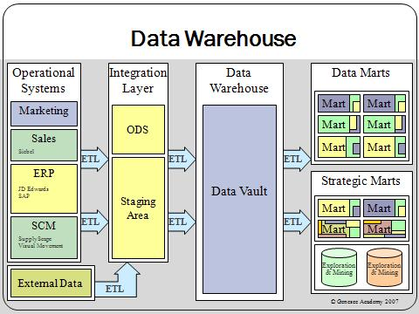
Data Warehouse

Slide 16
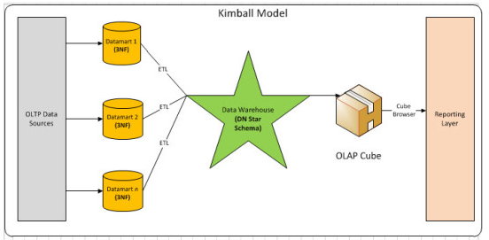
Data Warehouse – Kimball Model

Slide 17
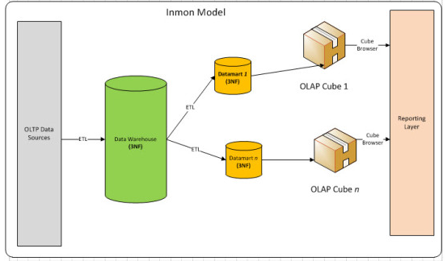
Data Warehouse – Inmon Model

Slide 18
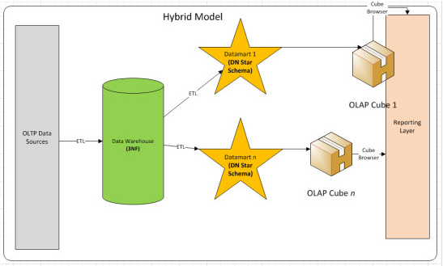
Data Warehouse – Hybrid Model

Slide 19
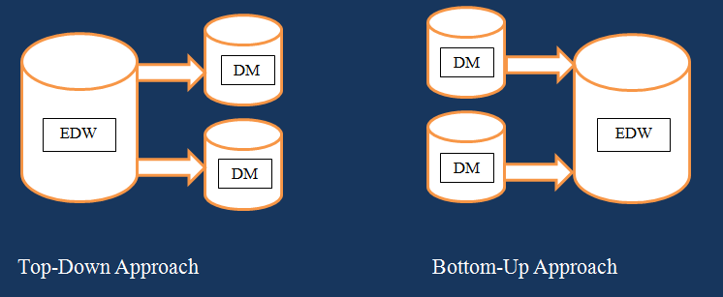
Data Warehouse
Inmon
Kimball

Slide 20
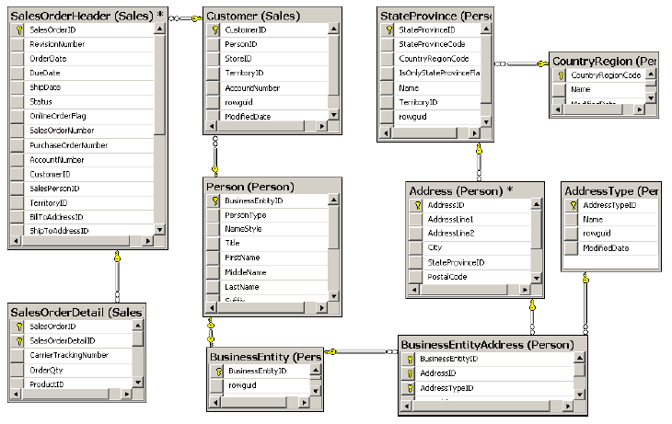
Reporting Problems with a Normalized Schema

Slide 21
Reporting Problems with a Normalized Schema
Comprehensive schema
Performance issues
Concurrency issues
LookUp table for Dates
Data Quality problem

Slide 22
Introducing Star and Snowflake Schemas
Introducing Star
and
Snowflake Schemas

Slide 23
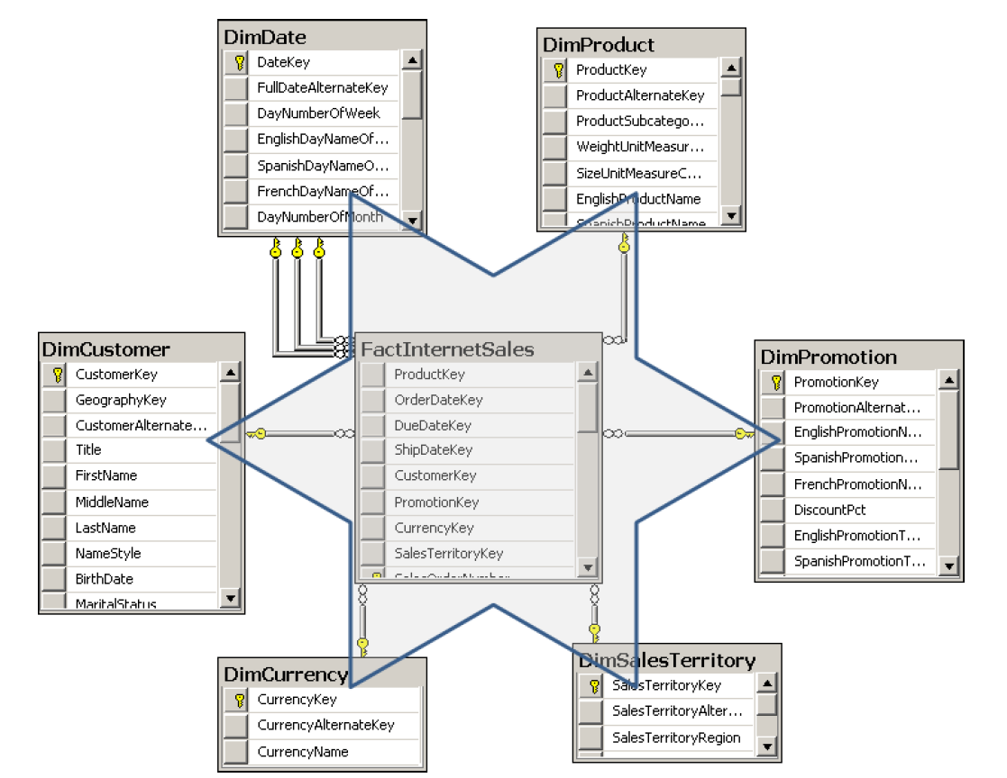
Star Schema
Dimension
Dimension
Dimension
Dimension
Fact Table
Dimension
Dimension

Slide 24
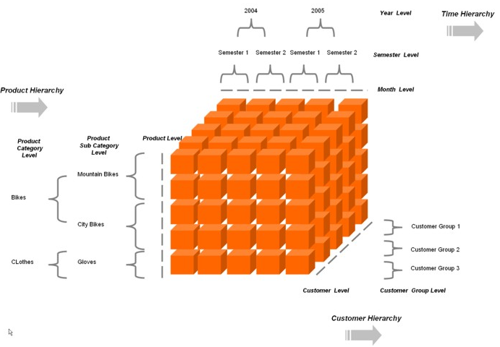
Star Schema – represent Multidimensional cube

Slide 25
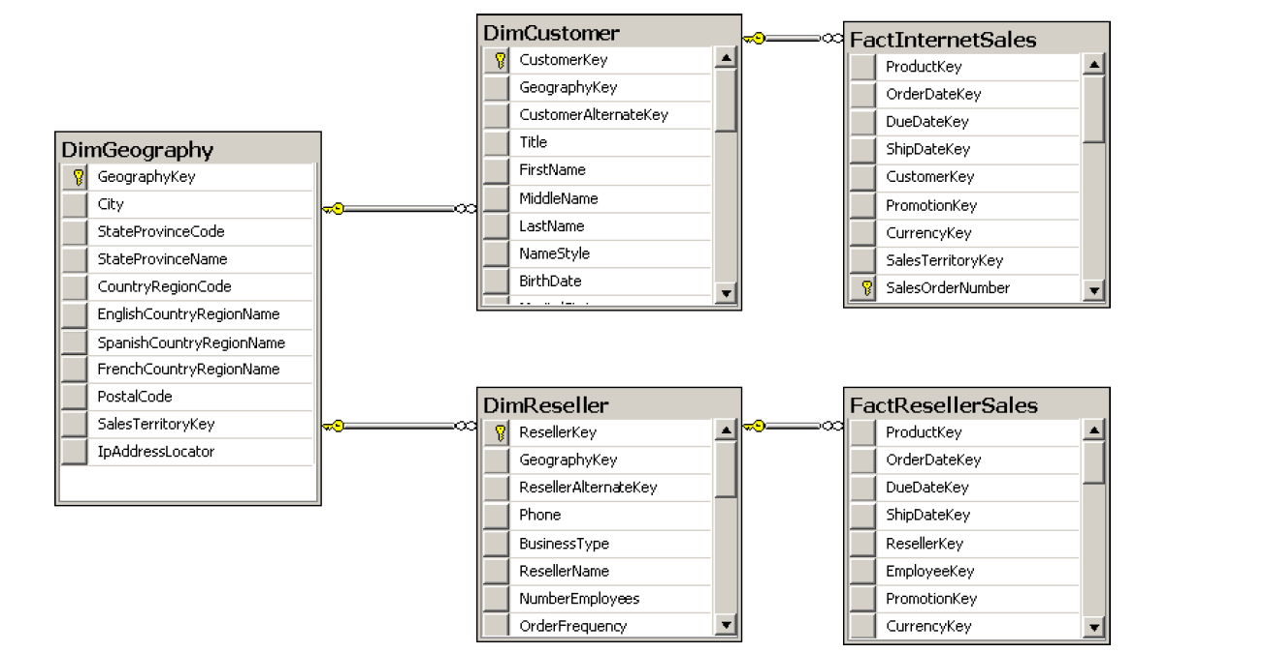
Snowflake Schema

Slide 26
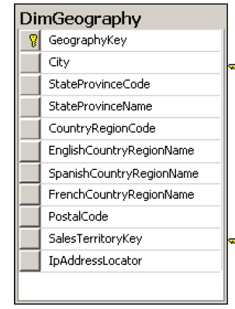
Snowflake Schema

Slide 27
Granularity Level
Notes:
Granularity Level
The number of dimensions connected with a fact table defines the level of granularity of
analysis you can get. For example, if no products dimension is connected to a sales fact table,
you cannot get a report at the product level—you could get a report for sales for all products
only. This kind of granularity is also called the dimensionality of a Star schema.
But there is another kind of granularity, which lets you know what level of information
a dimension foreign key represents in a fact table. Different fact tables can have different
granularity in a connection to the same dimension. This is very typical in budgeting and planning
scenarios. For example, you do not plan that customer A will come on date B to store C
and buy product D for amount E. Instead, you plan on a higher level—you might plan to sell
amount E of products C in quarter B in all stores in that region to all customers in that region.
Figure 1-7 shows an example of a fact table that uses a higher level of granularity than the
fact tables introduced so far.

Slide 28
Designing Dimensions
Designing Dimensions
Notes:
Star and Snowflake schemas are the de facto standard. However, the standard does not end
with schema shapes. Dimension and fact table columns are part of this informal standard as
well and are introduced in this lesson, along with natural hierarchies, which are especially useful
as natural drill-down paths for analyses. Finally, the lesson discusses a common problem
with handling dimension changes over time.

Slide 29
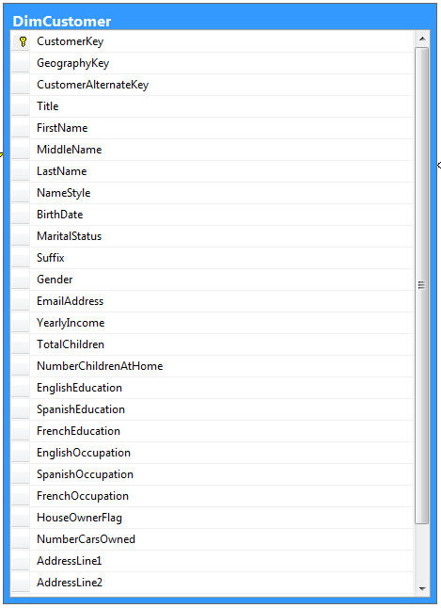
Dimension Column Types
Keys
Used to identify entities
Name columns
Used for human names of entities
Attributes
Used for pivoting in analyses
Member properties
Used for labels in a report
Lineage columns
Used for auditing, and never exposed to end users

Slide 30
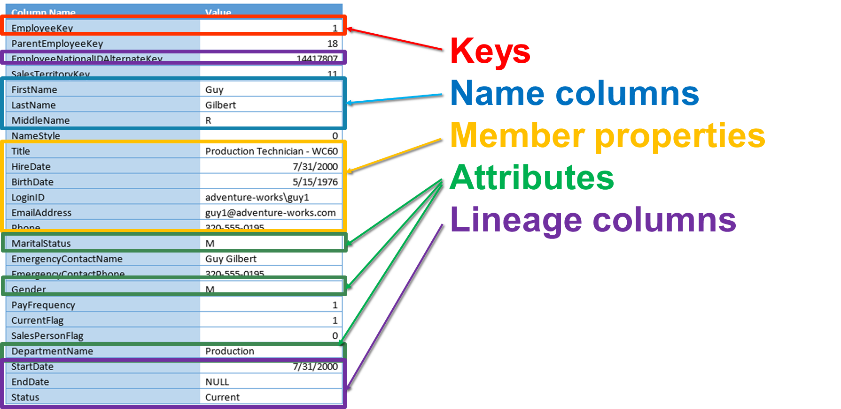
Dimension Column Types - DimEmployee

Slide 31
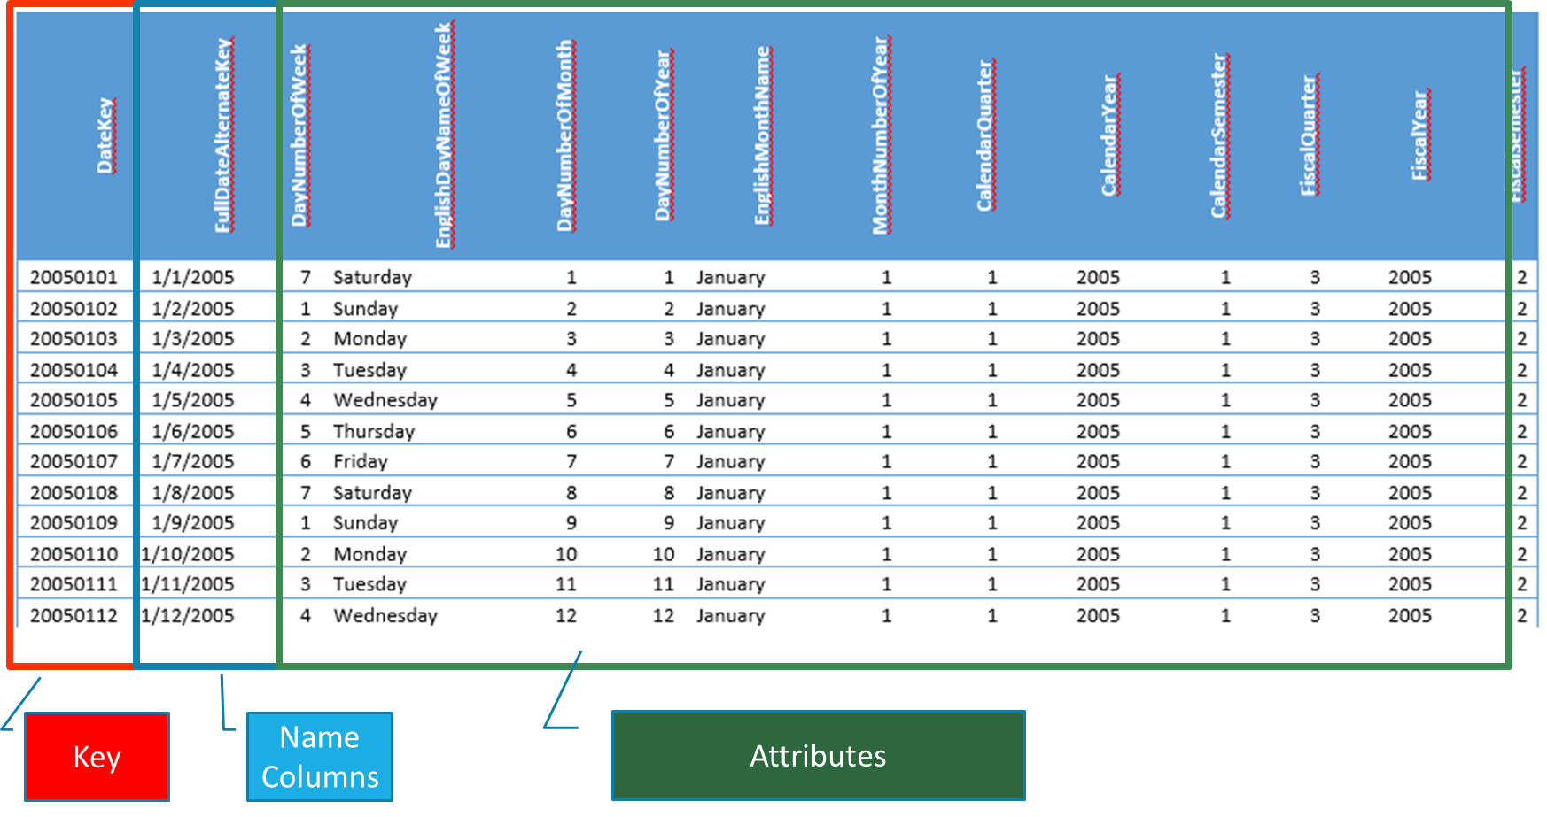
Dimension Column Types - DimDates

Slide 32
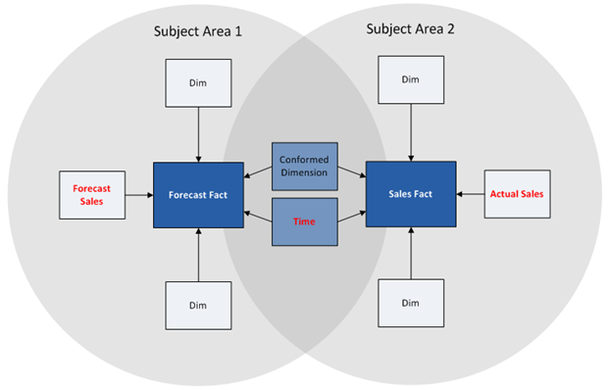
Dimension Types
Conformed dimension

Slide 33
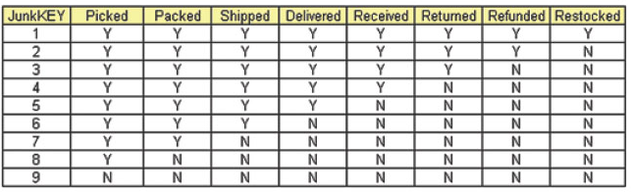
Dimension Types
Junk dimension

Slide 34
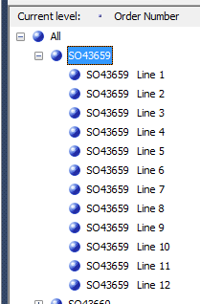
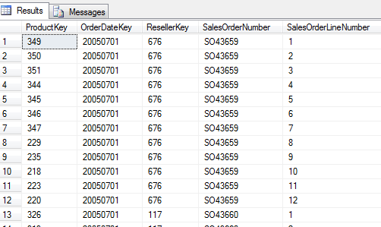
Dimension Types
Degenerate dimension

Slide 35
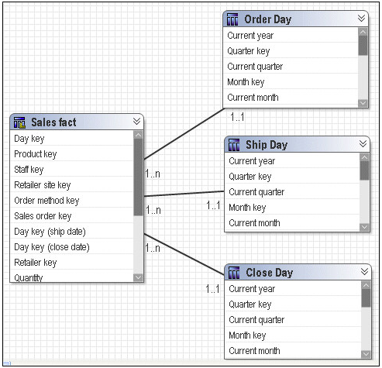
Dimension Types
Role-playing dimension

Slide 36
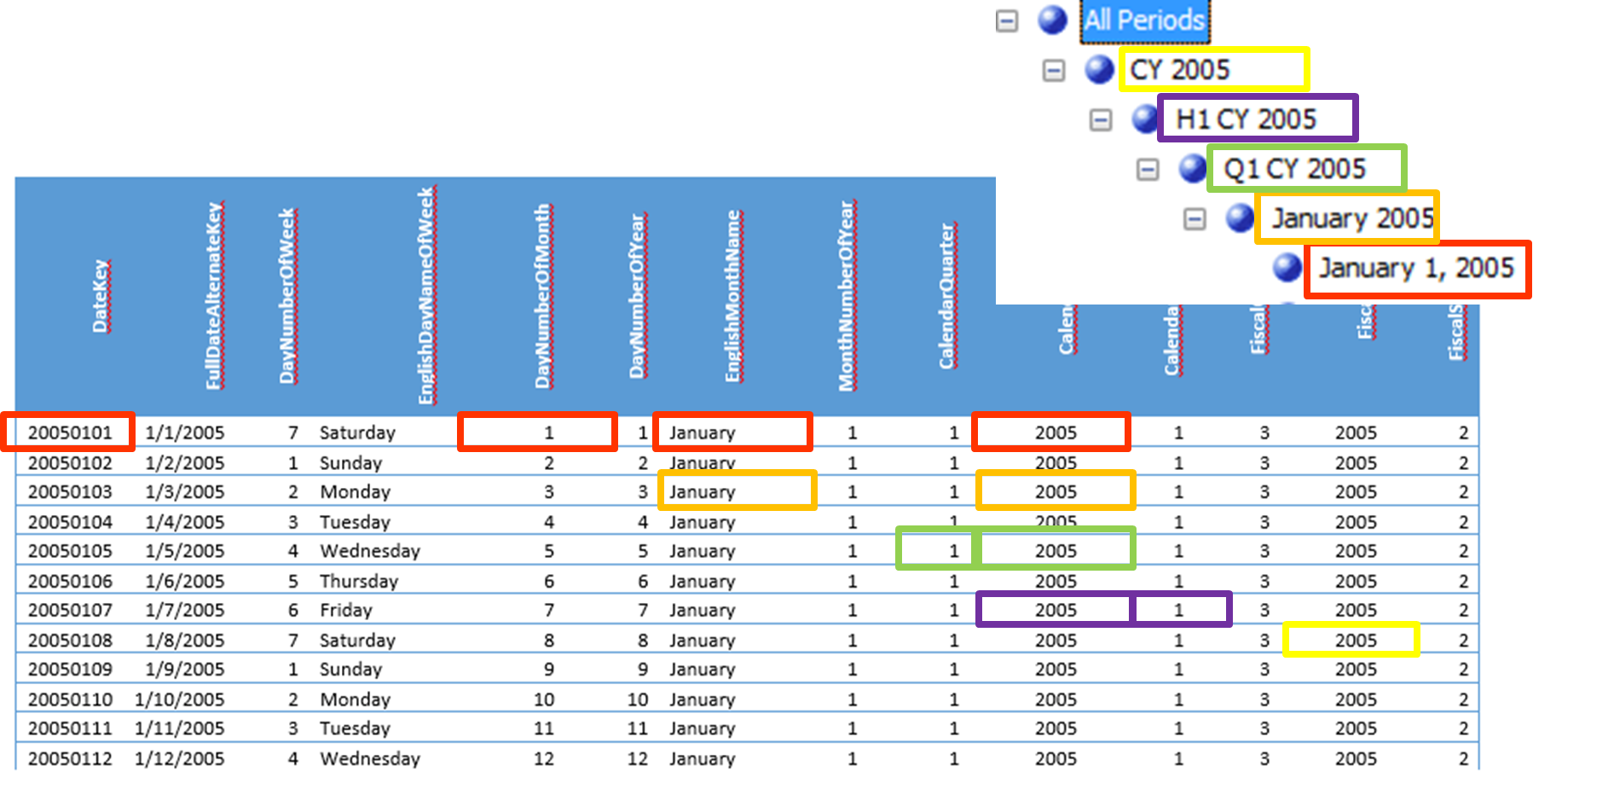
Hierarchies

Slide 37
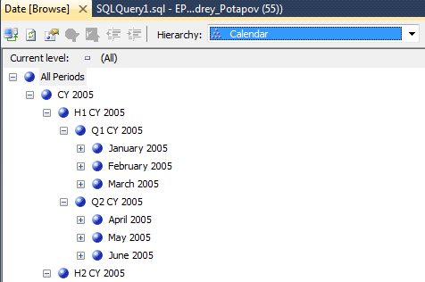
Hierarchies

Slide 38
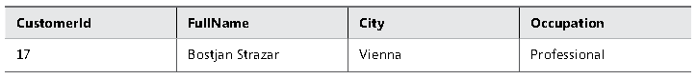
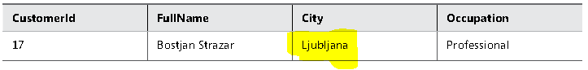
Slowly Changing Dimensions
SCD Type 1

Slide 39
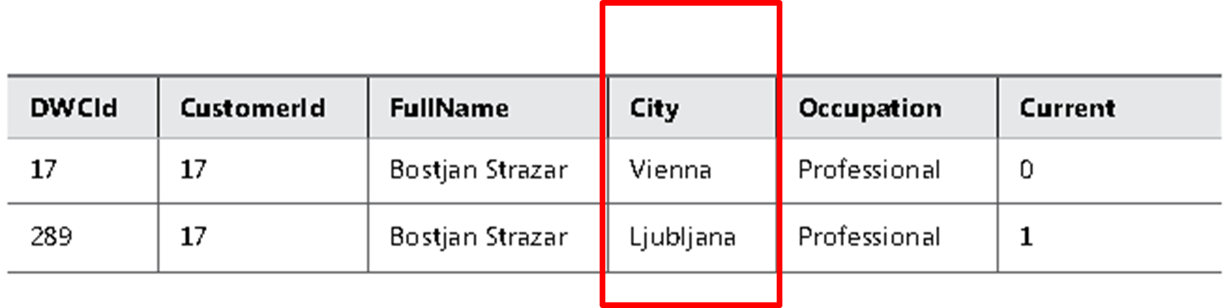
Slowly Changing Dimensions
SCD Type 2

Slide 40
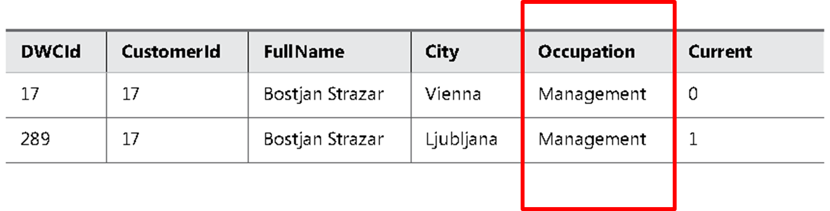
Slowly Changing Dimensions
An SCD Type 1 and Type 2 Mixture, Updating All Rows

Slide 41
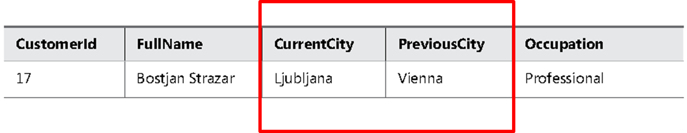
Slowly Changing Dimensions
SCD Type 3

Slide 42
Designing Fact Tables
Designing Fact Tables

Slide 43
Fact Table Column Types

Slide 44
Fact Table Column Types
Foreign keys
Measures
Lineage columns (optional)
Business key columns from the primary source table (optional)

Slide 45
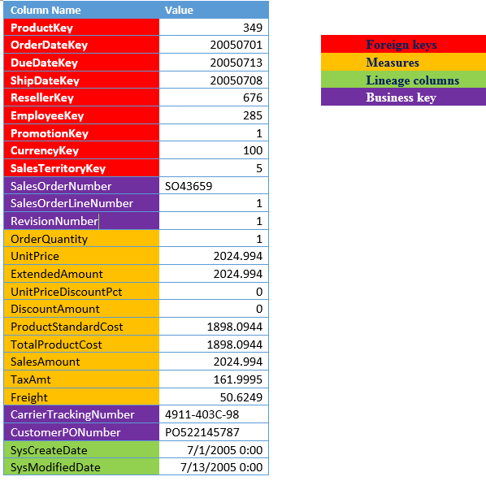
Fact Table Column Types
FactResellerSales

Slide 46
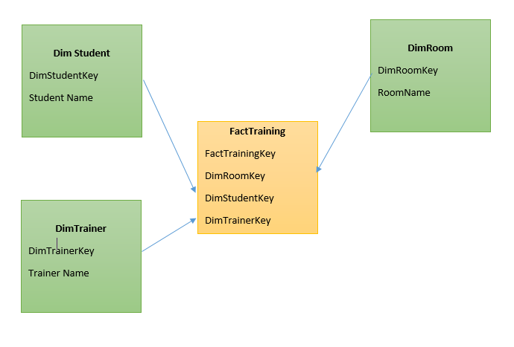
Fact Table Types
Factless Fact Table

Slide 47
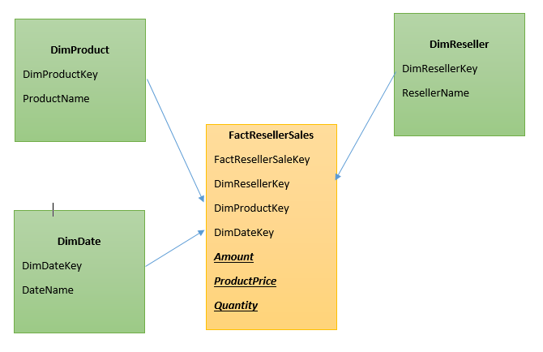
Fact Table Types
Transaction Fact Tables

Slide 48
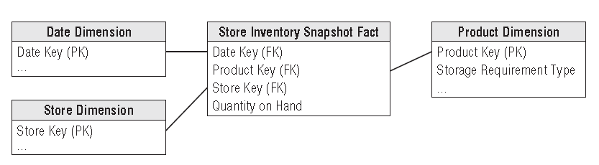
Fact Table Types
Periodic Snapshot Fact Tables

Slide 49
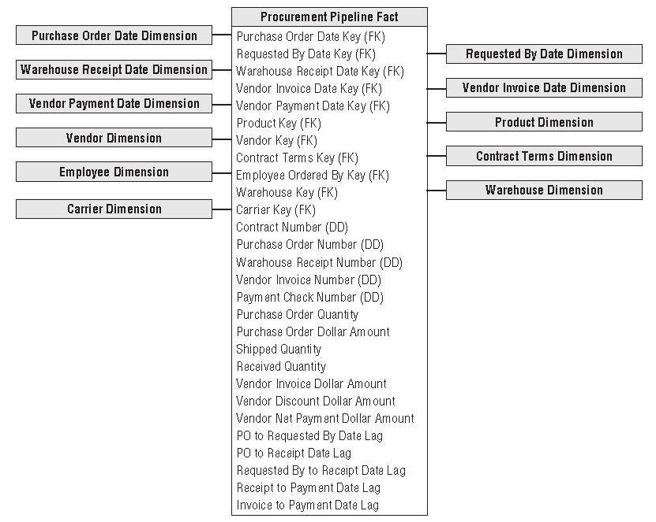
Fact Table Types
Accumulating
Snapshot Fact Tables

Slide 50
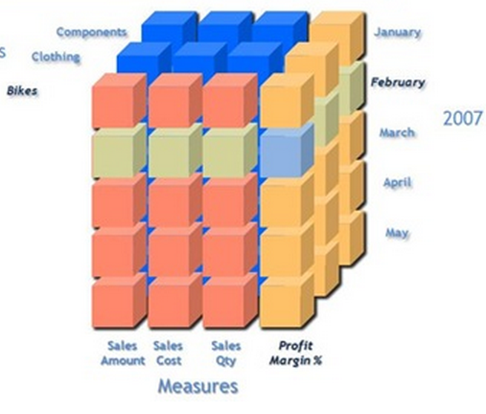
Additivity of Measures
Additive measures
Transaction amount
Semi-Additive measures
Account balance
Non-additive measures
Price
Notes:
Let us begin with the definition of each which will be followed by examples: 1. Additive measures: These are those specific class of fact measures which can be aggreagated across all dimension and their hieracchy 2. Semi-Additive measures: These are those specific class of fact measures which can be aggreagated across all dimension and their hieracchy except the time dimension 3. Non-additive measures: These are those specific class of fact measures which cannot be aggreagated across all/any dimension and their hieracchy
A good example of a non aggregatable measure might be 'Price' on a sales record. For example: A) We have sales figures...one may tend to add sales across all quareters to avail the yearly sales..hence this is an example of Additive measure B) We have stock levels say 1000(qty of Item A) on Monday...I sell 200(qty of Item A) on Tuesday I further sell 300(qty of Item A) on Wednesday...going by basic math On Thursday I should be left with 500(qty of Item A, assuming no inventory has flown in) to obtain current stock level I cannot aggregate the Stock sales across time dimension hierarchy...If done I will have inappropriate outcomes C) Aggregation of percentage or dates is an Ideal example of non-additive measures.
Additivity of measures is not exactly a data warehouse design problem. However, you should
consider which aggregate functions you will use in reports for which measures, and which aggregate
functions you will use when aggregating over which dimension.
The simplest types of measures are those that can be aggregated with the SUM aggregate
function across all dimensions, such as amounts or quantities. For example, if sales for product
A were $200.00 and sales for product B were $150.00, then the total of the sales was $350.00.
If yesterday’s sales were $100.00 and sales for the day before yesterday were $130.00, then
the total sales amounted to $230.00. Measures that can be summarized across all dimensions
are called additive measures.
Some measures are not additive over any dimension. Examples include prices and percentages,
such as a discount percentage. Typically, you use the AVERAGE aggregate function for
such measures, or you do not aggregate them at all. Such measures are called non-additive
measures. Often, you can sum additive measures and then calculate non-additive measures
from the additive aggregations. For example, you can calculate the sum of sales amount and
then divide that value by the sum of the order quantity to get the average price. On higher

Slide 51
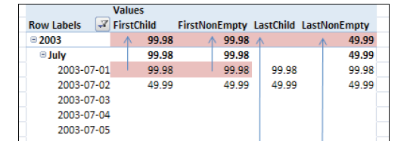
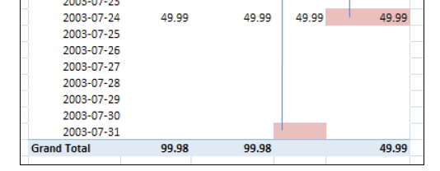
Additivity of Measures in SSAS
AverageOfChildren
FirstChild
LastChild
FirstNonEmpty
LastNonEmpty

Slide 52
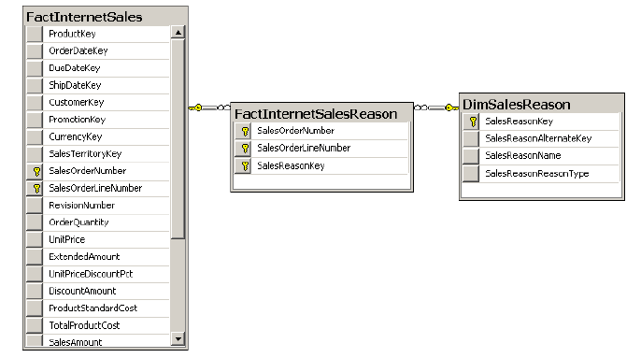
Many-to-Many Relationships
A classic many-to-many relationship

Slide 53
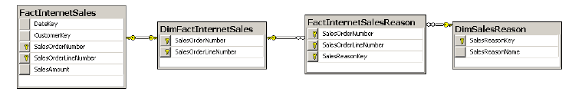
Many-to-Many Relationships
A many-to-many relationship with two intermediate tables

